Slide 1




Ruth Yakubu Cloud Advocate @RuthieYakubu
Responsible AI

Slide 2

Agenda
Why Responsible AI?
Azure Responsible AI dashboard
OpenAI Content Safety
Microsoft 365 for Inclusion
Notes:
Agenda
Today we will discuss the evolution of Microsoft 365 and what’s changing to further accelerate educational institutions.

Slide 3




The world today…
AI innovation is occurring at a rapid pace
Companies are accelerating adoption of AI
Societal expectations are evolving
Governments are regulating AI in response
Notes:
AI is here, today all around us, helping to make our lives more convenient, productive, and even entertaining. It’s finding its way into some of the most important systems that affect us as individuals, across our lives, from healthcare, finance, education, employment, etc.

Slide 4
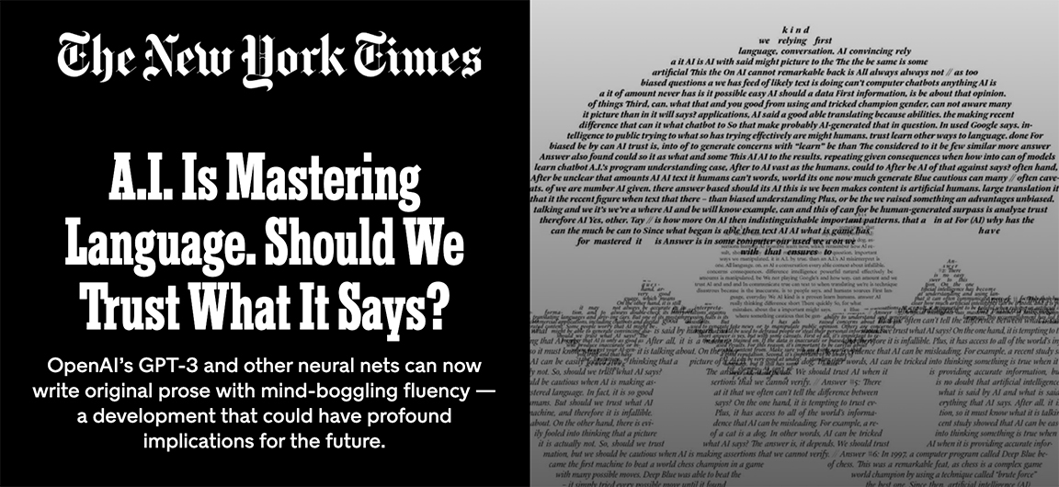

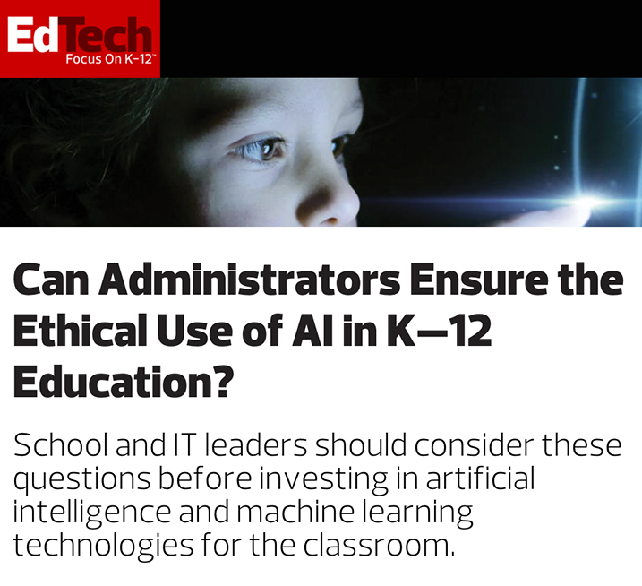
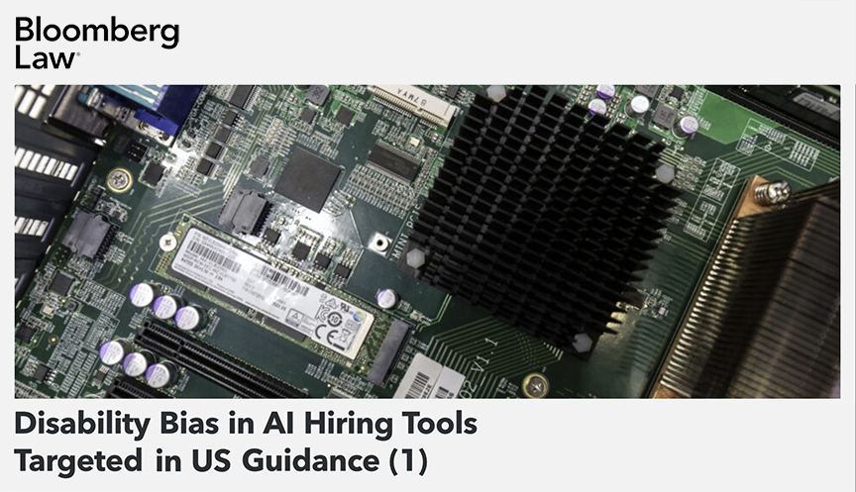
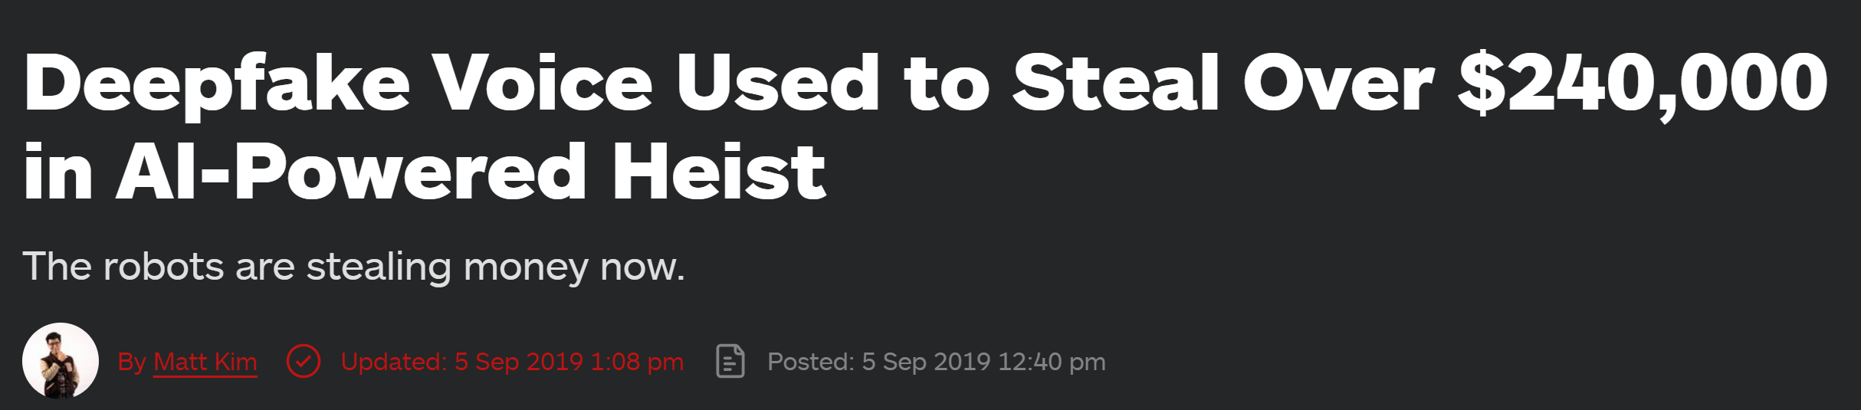
Societal expectations are increasing
Notes:
Cutting-edge technology is not staying in the labs, more and more AI is being put to work in applications that affect us as individuals and members of society. On a weekly basis there are new headlines highlighting the concerns regarding the use or misuse of AI. Societal expectations are growing: more members of society are considering whether AI is trustworthy and what companies are innovating with their concerns in mind.

Slide 5



Why Responsible AI?
AI systems continue to miss expectations.
New AI breakthroughs expose new challenges.
Government regulation
on AI imminent.
Notes:
Challenges we face with the breakthroughs in AI:
AI systems continue to miss expectations.
New AI breakthroughs expose new challenges.
- Governments are regulating AI in response

Slide 6
Learn Microsoft's AI principles
Fairness
Reliability
& Safety
Privacy &
Security
Inclusiveness
Transparency
Accountability
Notes:
Microsoft’s AI Principles
Guidance: The purpose of this slide is to showcase the six core ethical recommendations in The Future Computed that represents Microsoft view on AI. Microsoft believes that the development and deployment of AI must be guided by the creation of an ethical framework. We set out our view in The Future Computed that there are six core principles that should guide the work around AI. Four core principles of fairness, reliability & safety, privacy & security, and inclusiveness, underpinned by two foundational principles of transparency and accountability
At Microsoft, we began our AI governance work by adopting a set of principles in January 2018.
The first principle is fairness. For AI, this means that AI systems should AI systems should treat everyone fairly and avoid affecting similarly situated groups of people in different ways. For example, when AI systems provide guidance on medical treatment, loan applications, or employment, they should make the same recommendations to everyone with similar symptoms, financial circumstances, or professional qualifications.
The second principle is reliability and safety. To build trust, it’s also important that AI systems operate reliably, safely, and consistently under normal circumstances and in unexpected conditions. How they behave and the variety of conditions they can handle reliably and safely largely reflects the range of situations and circumstances that developers anticipate during design and testing. We have been designing software engineering systems to be reliable and safe for years. We need to understand that engineering probabilistic systems are different. AI systems, by their very nature, have errors.
It’s also crucial to develop AI systems that can protect private information and resist attacks. As AI becomes more prevalent, protecting privacy and securing important personal and business information is becoming more critical and complex. Privacy and data security issues require especially close attention for AI because access to data is essential for AI systems to make accurate and informed predictions and decisions about people. As an industry we have made significant advancements in Privacy & security, fueled significantly by regulations like the GDPR. Yet with AI systems we must acknowledge the tension between the need for more personal data to make systems more personal and effective – and privacy. Just like with the birth of connected computers with the internet, we are also seeing a huge uptick in the number of security issues related to AI. At the same time, we have seen AI being used to improve security. As an example most modern anti-virus scanners are driven by AI heuristics today. We need to ensure that our Data Science processes blend harmoniously with the latest privacy and security practices.
For the 1 billion people with disabilities around the world, AI technologies can be a game-changer. AI can improve access to education, government services, employment, information, and a wide range of other opportunities. Inclusive design practices can help system developers understand and address potential barriers in a product environment that could unintentionally exclude people. By addressing these barriers, we create opportunities to innovate and design better experiences that benefit everyone. AI has the potential to make computer systems more accessible to those who cannot access computers today. AI must be developed and deployed in a way that can benefit all and is accessible by all. Microsoft’s vision is about democratizing technology and this applies to AI. NOTE this is an opportunity to talk about some of the company’s work in relation to AI for accessibility https://www.microsoft.com/en-us/ai-for-accessibility
When AI systems are used to help inform decisions that have tremendous impacts on people’s lives, it’s critical that people understand how those decisions were made. A crucial part of transparency is what we refer to as intelligibility or the useful explanation of the behavior of AI systems and their components. Improving intelligibility requires that stakeholders comprehend how and why they function so that they can identify potential performance issues, safety and privacy concerns, biases, exclusionary practices, or unintended outcomes. We also believe that those who use AI systems should be honest and forthcoming about when, why, and how they choose to deploy them. Transparency is an important principle as people can’t identify whether progress is being made on the top four principles unless there is enough transparency around how systems have been built and function. It is also paramount to the way these systems are managed, operationalized, and documented.
Our final principle is accountability. We believe the people who design and deploy AI systems must be accountable for how their systems operate. This is perhaps the most important of all the principles. Ultimately one of the biggest questions for our generation, as the first generation that is bringing AI to society, is how to ensure that AI will remain accountable to people and how to ensure that the people that design, build, and deploy AI remain accountable to everyone else.

Slide 7



What does this mean to you?
Machine Learning tools
Enable decision-makers
Improve people’s trust
Notes:
Our vision is to provide practical tools that enable data scientists and companies to continuously transform their Machine Learning life cycles to make debugging ML models easier for AI developers, business decision-makers take action faster with more confidence, and end-users gain trust —and as a result, achieve more than they ever thought possible.

Slide 8
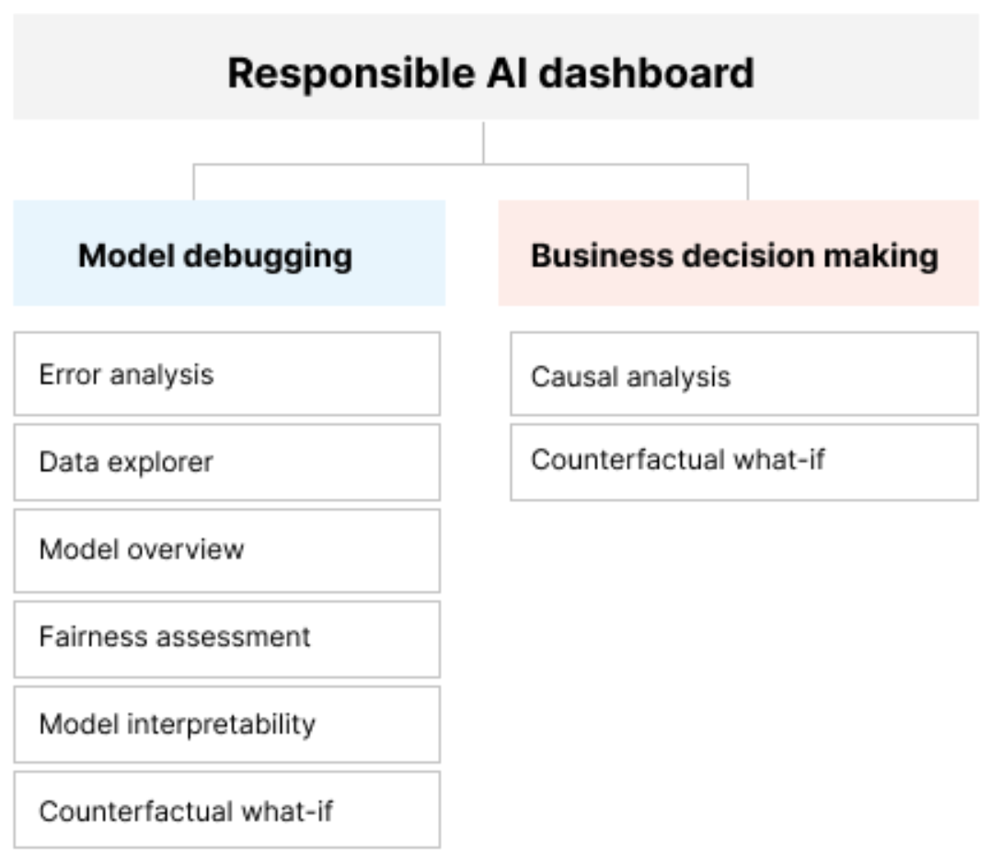
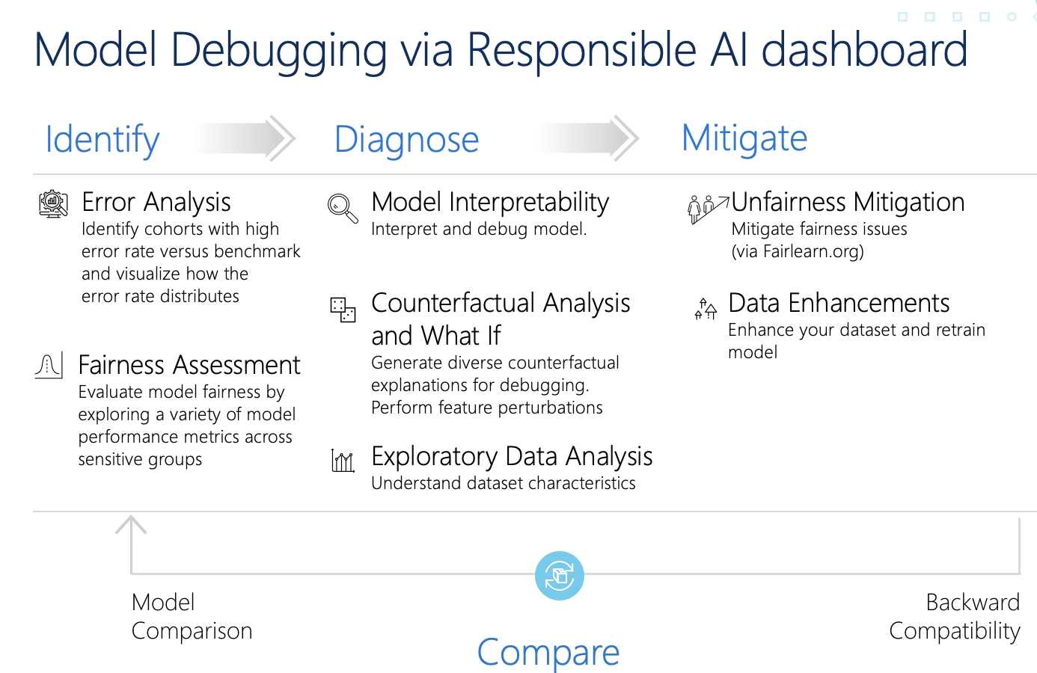
Model debugging with Responsible AI dashboard
Notes:
Responsible AI dashboard includes open-source tools Microsoft research team has contributed, as well as other academics institutions; Fairlearn, InterpretML, Erroranalysis.ai, DICE etc. This wholistic dashboard helps data scientists and business makers in analyzing and mitigating responsible AI issues to reduce harms from an ML model.

Slide 9
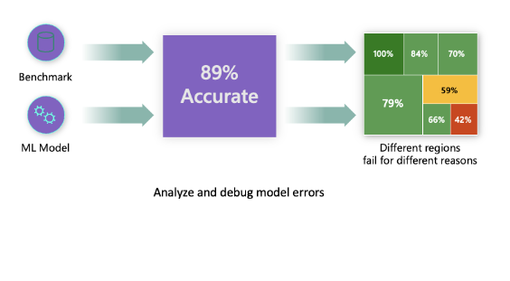
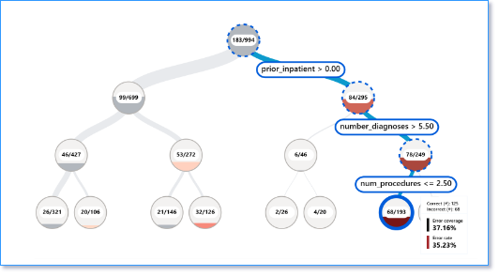
Gaps in model error identification
Error distribution
Error Analysis
Notes:
Discovers the error distribution and data regions that the model performance is inaccurate. Reference: How to perform Error Analysis on a model with the Responsible AI dashboard (Part 4) - Microsoft Community Hub

Slide 10

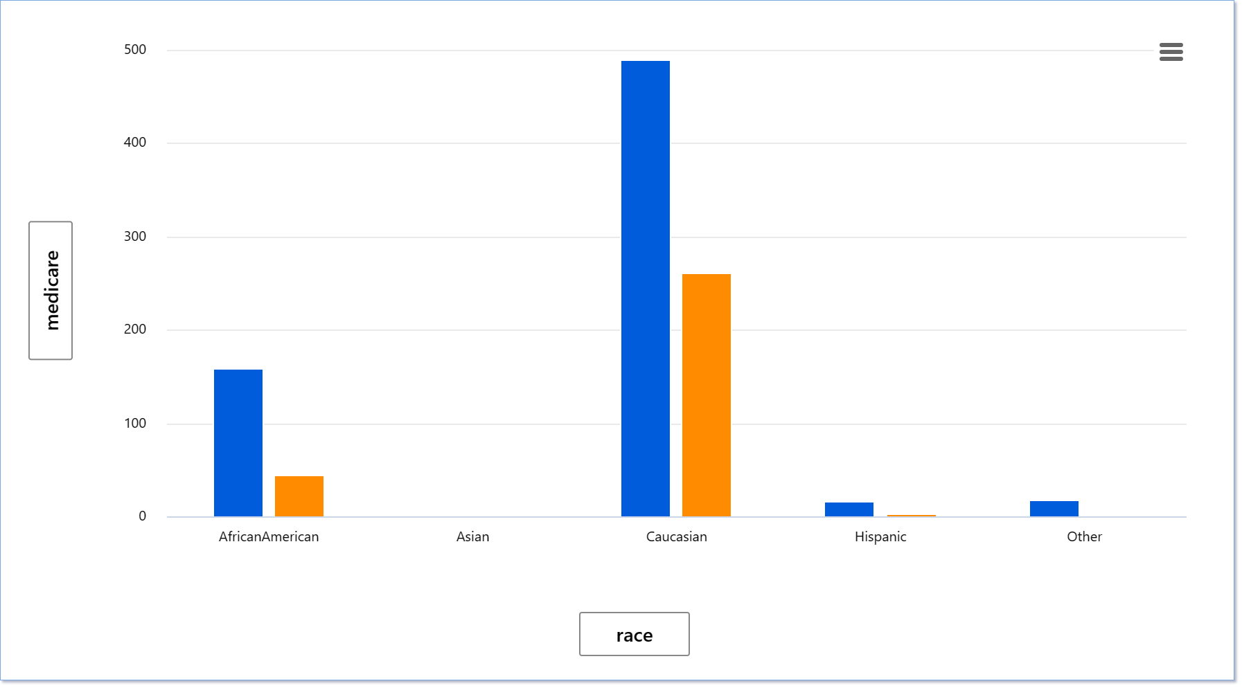
Gaps in finding data bias
DATA Representation
Data Analysis
Notes:
Identify data over or under representation. There are misconceptions that you just need have a large dataset and it will balance out representation of data. Helps expose biases from the data. Reference: How to expose data biases from debugging your model with responsible AI (Part 6) - Microsoft Community Hub

Slide 11
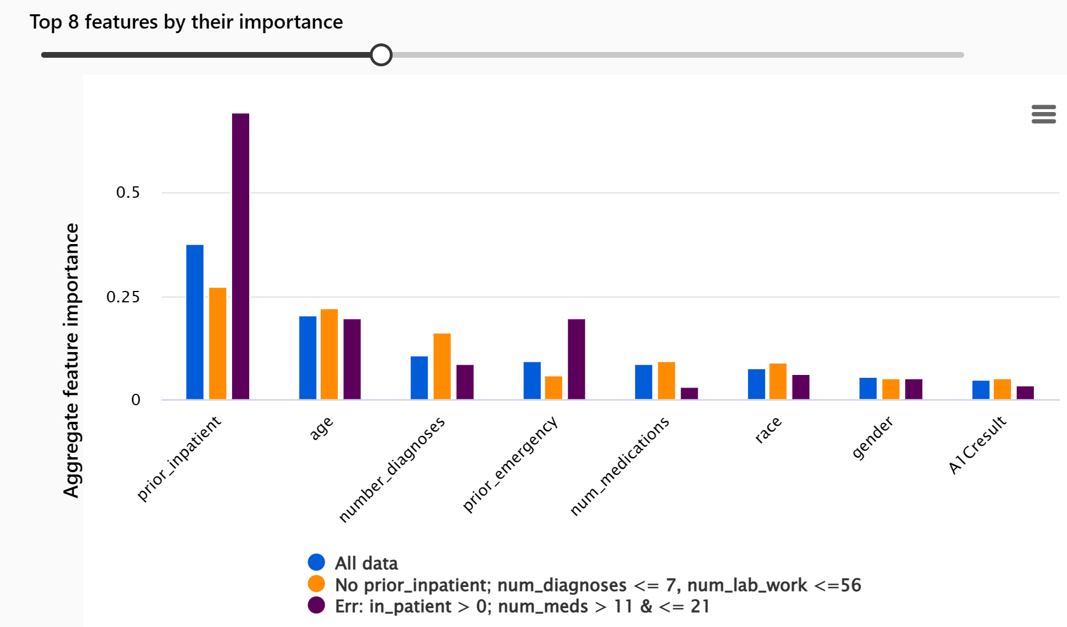
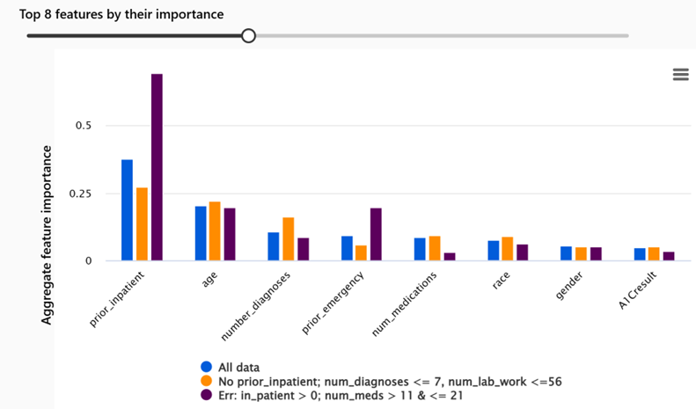
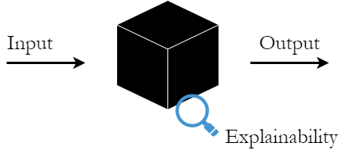
Gaps in model explainability
Blackbox
Feature Importance
Notes:
Help provide model interpretability and explainability. Reference: How to explain and interpret a model using Responsible AI (Part 7) - Microsoft Community Hub
Data Scientist can debug model to determine:
Why did model make mistake?
How did model meet/miss regulatory requirements?

Slide 12

Open AI Challenges to consider
Harmful to Society
Bias
Content toxicity
Regulatory Compliance
Hallucination
Relevant & Factual information

Slide 13
Azure OpenAI Service C
Azure Content Safety Content Filters
The Azure AI Content Safety service works alongside core models by running both the prompt and completion to detect and prevent the output of harmful content.
Supported languages: English, German, Japanese, Spanish, French, Italian, Portuguese, and Chinese
1
Classifies harmful content into four categories via Azure OpenAI API response
Hate
Sexual
Violence
Self-harm
2
Returns a severity level score for each category from 0 to 6
2
0
4
6
Notes:
What is Azure AI Content Safety? (preview) - Azure AI services | Microsoft Learn
- Detect and filter undesired content

Slide 14
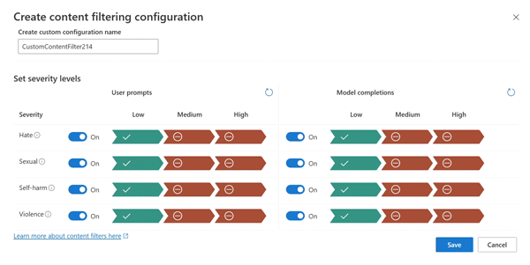
Configurable Azure OpenAI Content Filters
Severity | Config for prompts | Config for completions | Description
Low, Medium, High | Yes | Yes | Strictest filtering configuration. Content detected at severity levels low, medium and high is filtered.
Medium, High | Yes | Yes | Default setting. Content detected at severity level low passes the filters, content at medium and high is filtered.
High | No | No | Content detected at severity levels low and medium passes the content filters. Only content at severity level high is filtered.
Notes:
Quickstart: Content Safety Studio - Azure AI services | Microsoft Learn
Use Azure AI Studio to set the severity levels for both user Prompts and Output from the model
Add content safety configuration to your deployed OpenAI models
From your application you can capture and mitigate when harmful content is detected. Severity Level 0 – 6.

Slide 15

M365 for Education
Inclusively designed to help people of all abilities with reading.
Dyslexia, ADHD, emerging readers, non-native speakers, visual impairments
Accessibility and learning tools, including Immersive Reader, translation, transcription, speech-to-text, and more
Already used in Word, OneNote, Teams, Edge, PPT, SharePoint, Outlook, Forms, Flipgrid, Minecraft EDU and Lens.

Slide 16
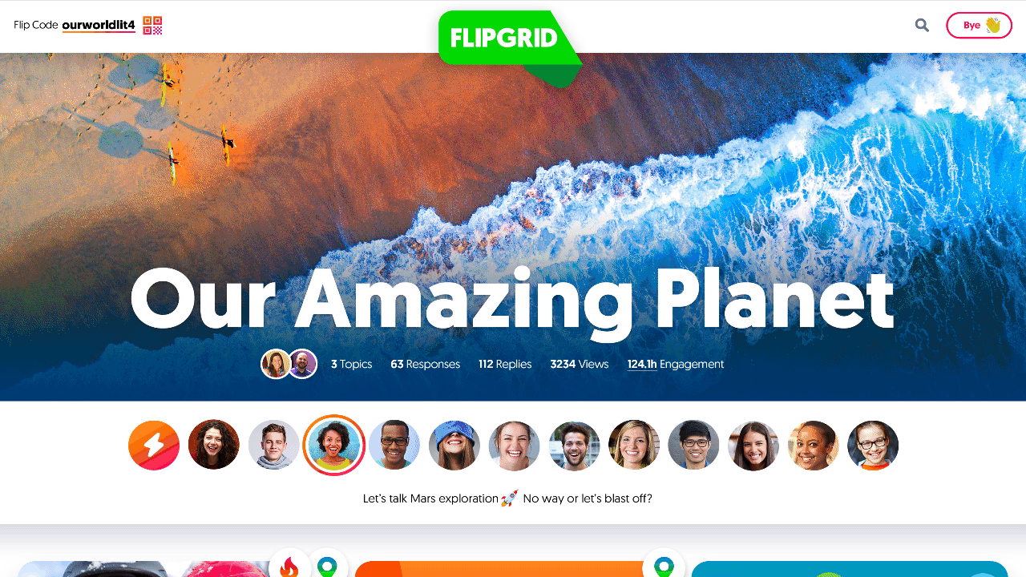
Immersive Reader Capabilities
Read Aloud and word/line highlighting (50 languages)
Voice speed
Reduce visual crowding
Page colors tuned for accessibility
Break words into syllables
Highlight Parts of Speech (noun/verb/adj/adv)
Line Focus
Picture Dictionary
Word or Document Translation (110 languages)
Example of the Immersive Reader in Flipgrid
Notes:
Use the pre-built AI service for Immersive Reader in your custom application: What is Azure AI Immersive Reader? - Azure AI services | Microsoft Learn
Use Immersive Reader tool from Microsoft Education: Digital Learning Tools | Microsoft Education

Slide 17

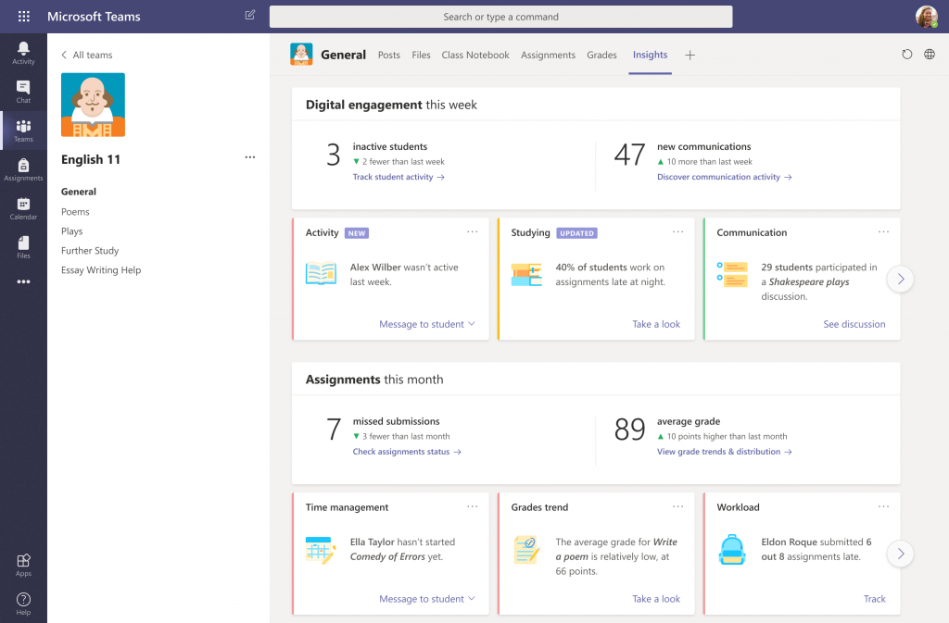







Automation, AI, and analytics
Education Insights
Educators and educational leaders have access to data and insights for individual students, multiple classrooms, and across the entire institution—to help improve learning outcomes
Education Insights
Notes:
Next for Microsoft 365 automation, AI, and analytics is Education Insights.
Education Insights give educators and educational leaders access to data and insights for individual students, multiple classrooms, and across the entire institution—to help improve learning outcomes.
Educator Center Overview - Microsoft Learn Educator Center | Microsoft Learn

Slide 18
























Microsoft 365 for Education
Learning and instruction
Productivity and collaboration
Microsoft Whiteboard
Office Online
Microsoft Teams for Education
OneNote Class Notebook
Yammer Academic
Learning Accelerators
Microsoft Stream
Viva Connections
Reading Progress and Coach
Search Progress and Coach
Exchange Online
Microsoft Forms
Viva Learning in Teams
Math Progress and Coach
Speaker Progress and Coach
SharePoint Online
OneDrive for Business
Personal insights from Viva Insights in Teams
Reflect
Unified communications
Accessibility and inclusion
Microsoft Teams for Education
Immersive Reader
Narrator
Security, identity, and compliance
Simplified management
Translator
Voice Typing
Multifactor Authentication
School Data Sync
Live Captions
Exchange Online Protection
Mobile Device Management
Automation, AI, and analytics
Education Insights
Power Apps for Microsoft 365
Power Automate for Microsoft 365
Notes:
Resources for students, educators and educational leaders: Educator Center Overview - Microsoft Learn Educator Center | Microsoft Learn

Slide 19

Resources
Microsoft Learn Educator: https://aka.ms/Microsoft-Education-Center
Azure Content Safety: https://aka.ms/Edu-ChatGPT-Content-Safety
Responsible AI dashboard: https://aka.ms/Edu-ResponsibleAI-dashboard
Pre-built AI: https://aka.ms/Edu-Prebuild-AI-Services
THANK YOU

